Slide 1
Pressure Mapping for Pressure Ulcer Prevention and Management
Amanda Morina, PT, DPT, NCS
Thomas Jefferson University Hospital
Department of Rehabilitation Medicine
Neurologic Clinical Specialist
amanda.morina@jefferson.edu

Slide 2
Objectives
Learner will describe 2 indications and the basic function of pressure mapping system for pressure ulcer prevention
Learner will describe 3 characteristics of pressure maps that indicate increased risk of skin breakdown
Learner will describe appropriate pelvic positions on sitting and bed support systems to decrease risk of pressure ulcers at the sacrum
Learner will identify 2 ways in which caregivers can incorporate change in his/her current clinical practice based on pressure mapping data

Slide 3
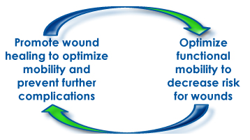
Disclosure
No financial interest in any product represented
No conflicts of interest with vendors/manufacturers
Written consent obtained for photos by patients or POA
Physical Therapy
www.hyox.com

Slide 4

Healthy subjects move every 6 minutes in the sagittal plane and every 9 minutes in the frontal plane*
*Linder-Ganz

Slide 5
Contributing Factors to Pressure Ulcer Formation
Moisture
Friction
Shear
Pressure
contact pressure exceeding mean pressure in capillary veins
collapsed veins
tissue ischemia
necrosis

Slide 6
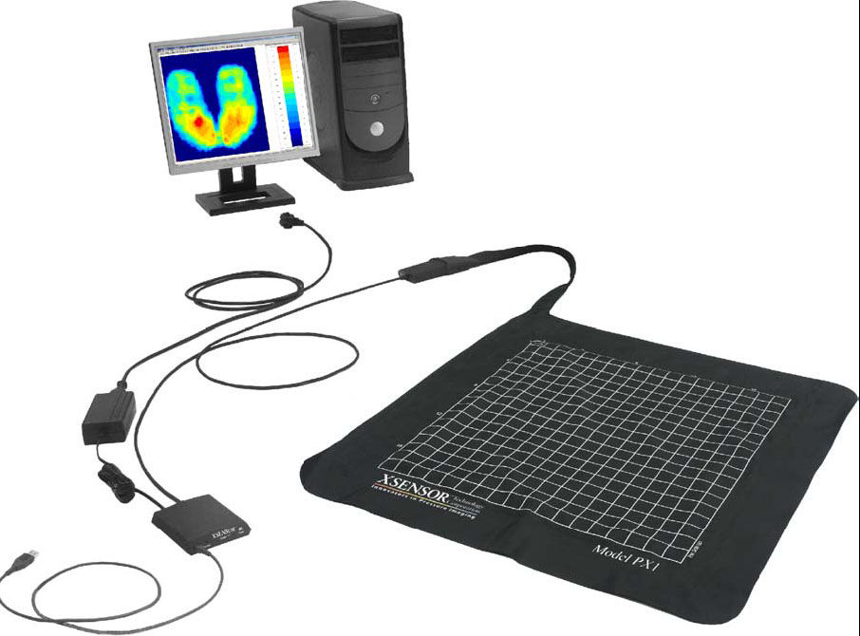
What is
Pressure Mapping?
Computerized display of interface pressure between 2 surfaces
Data quantified through multi sensors on thin, flexible material placed between patient and support surface
Parry, NPUAP
www.xsensor.com
Notes:
Uses include automotive industry, consumer mattresses, healthcare

Slide 7
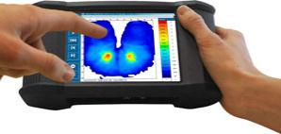
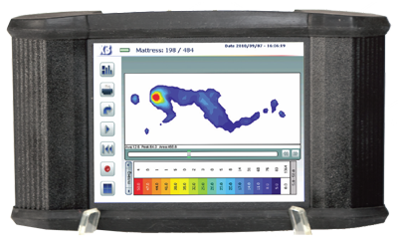
Data
Displays:
  Color-scaled representation of pressure forces
  Pictorial image of symmetry/surface area
  Peak and average pressures and (mmHg)
Objective documentation tool
Biofeedback for effectiveness if weightshifts
Monitors body position over time
Shapcott & Levy, Ferguson-Pell & Bain
Notes:
Display unit allows for mapping duing dynamic wheelchair mobility or for portability to keep with patient throughout day

Slide 8
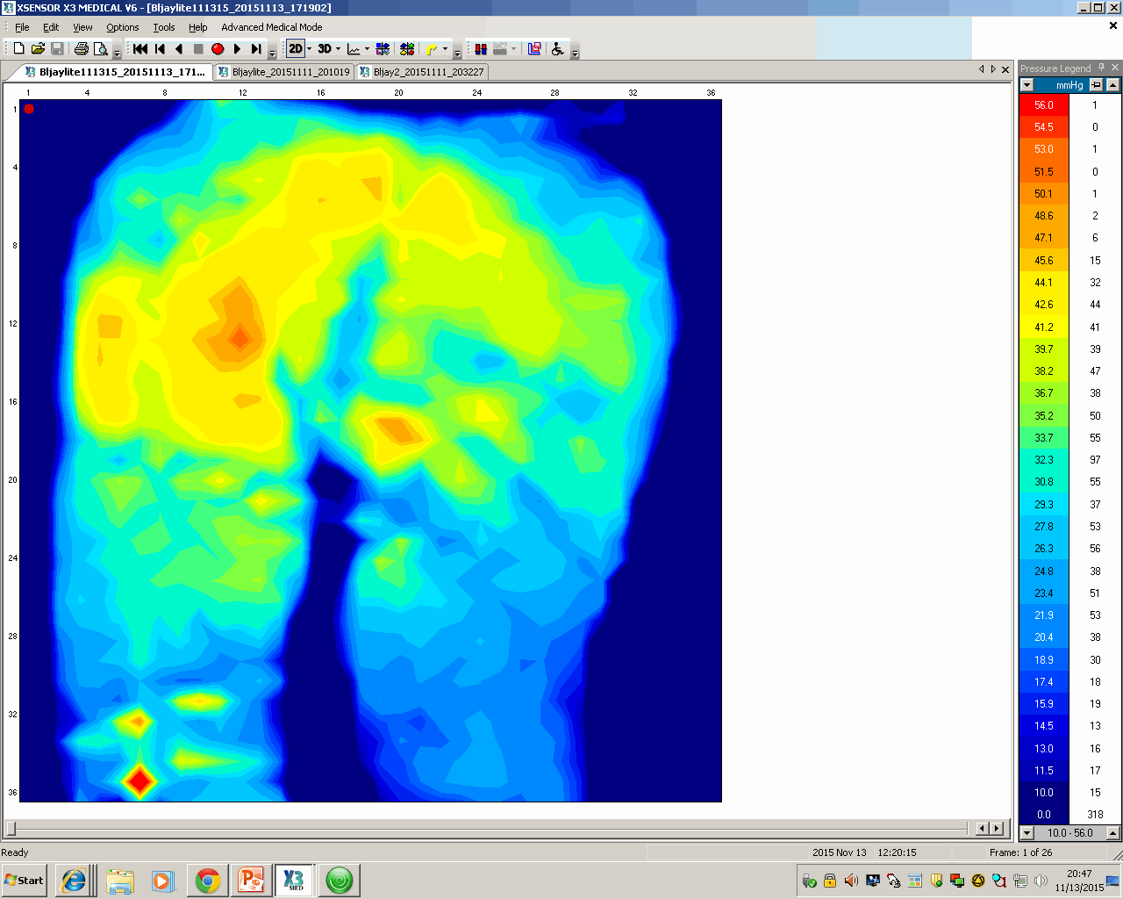
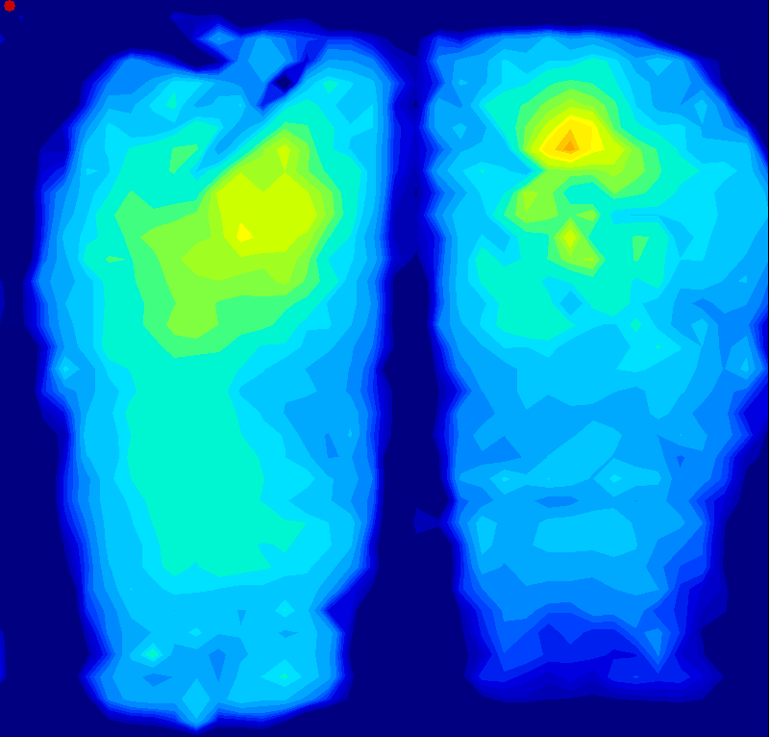
Interpreting the Image
RED
More Pressure
BLUE
Less Pressure
Notes:
Allow for creep

Slide 9
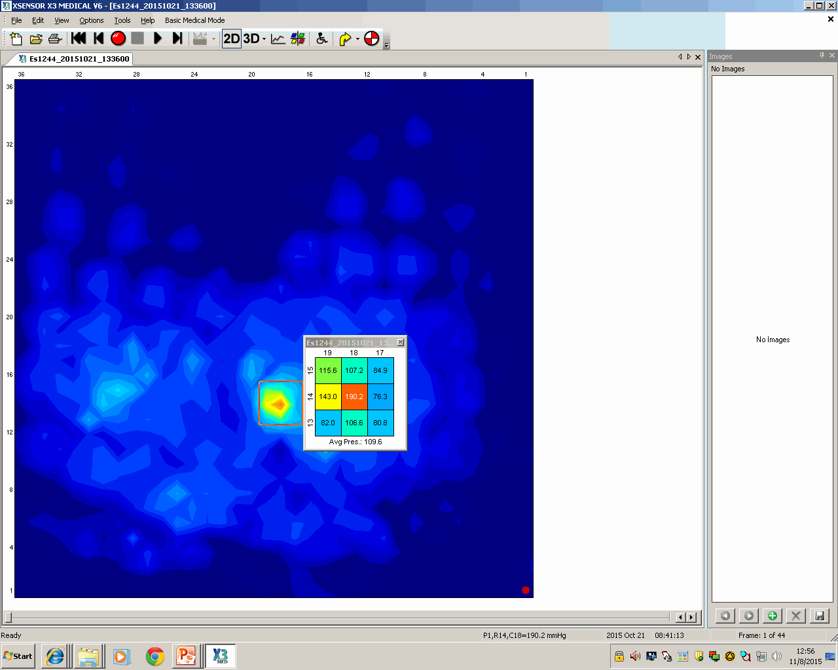
Quantifying Interface Pressures
There is no universal recommended mmHg as body type, support surfaces, and other factors like shear and moisture effect wound formation
Historically, 32mmHg* considered tissue
tolerance
Recent studies = 60mmHg**
A study by Bennet et al provides
relative values***:
Body Part | Injury Threshold
Thigh Area | 80 mmHg
Ischia | 40 mmHg
Coccyx | 14 mmHg
* Landis
** Bar et al
***Bennett et al
Notes:
9

Slide 10
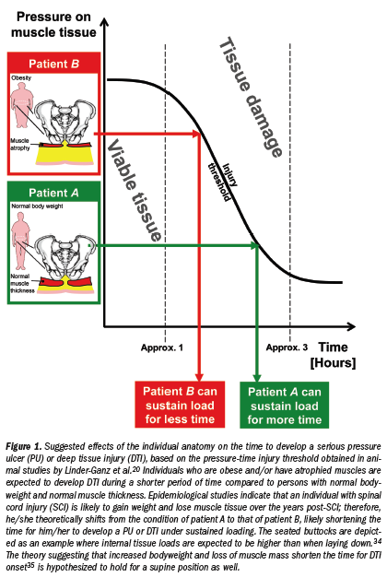
Pressure-Time Curve*
PRESSURE
TIME
Tissue damage can result from high pressures over a short time period
Tissue damage can result from low pressures over a long time period
*Gefen

Slide 11
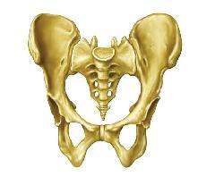
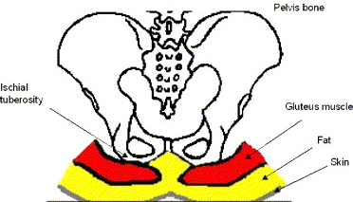
Pelvic Positioning in Sitting
Ischial Tuberosities
•Rounded Shape
• Muscle and Fat Cushioning
Sacrum and Coccyx
• Pointed Shape
• Little Muscle/Fat Cushioning
Figure: Linder-Ganz

Slide 12
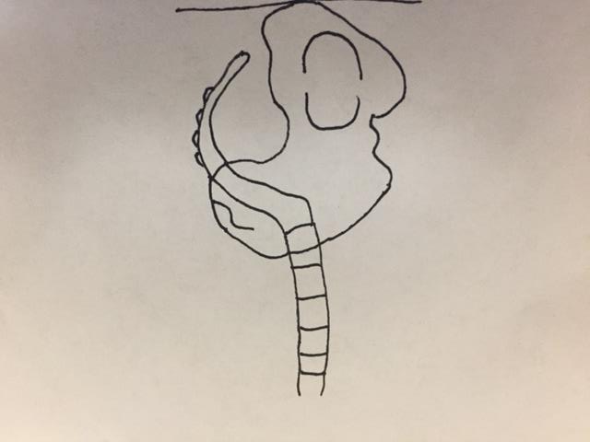
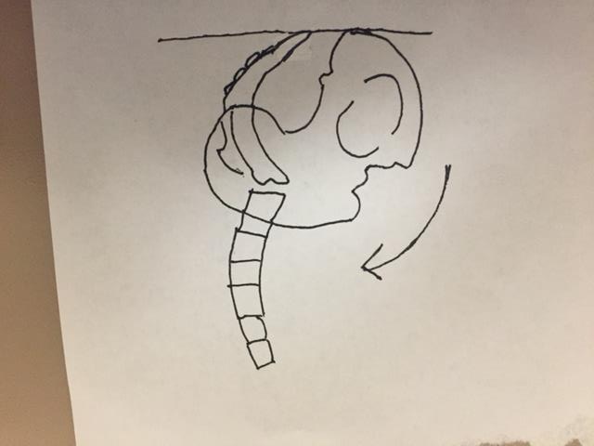
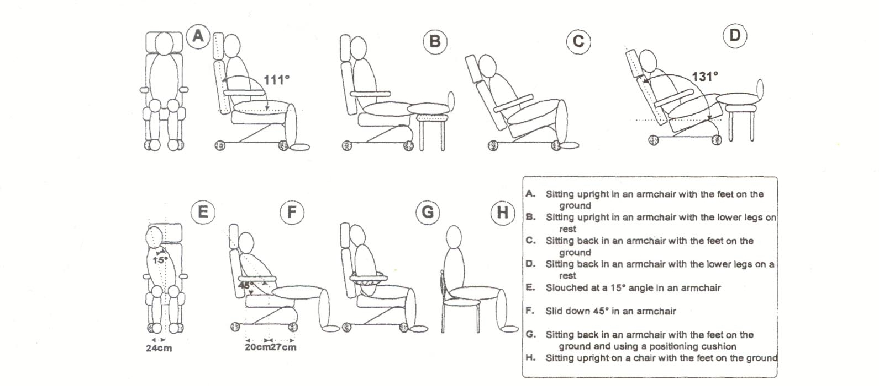
Sacral Sitting*
1. Increased PRESSURE interface between the sacrum and the back of the chair
2. Loading of the coccyx (PRESSURE)
3.Results in SHEAR forces at ischial bones
A slouched position (sacral sitting) yields the highest interface pressures**
*Bergstrom et al, Sprigle et al
**Defloor et al

Slide 13
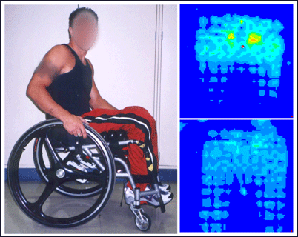
Surface Area/Contour
*Betz

Slide 14
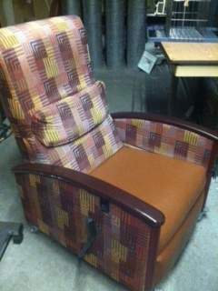
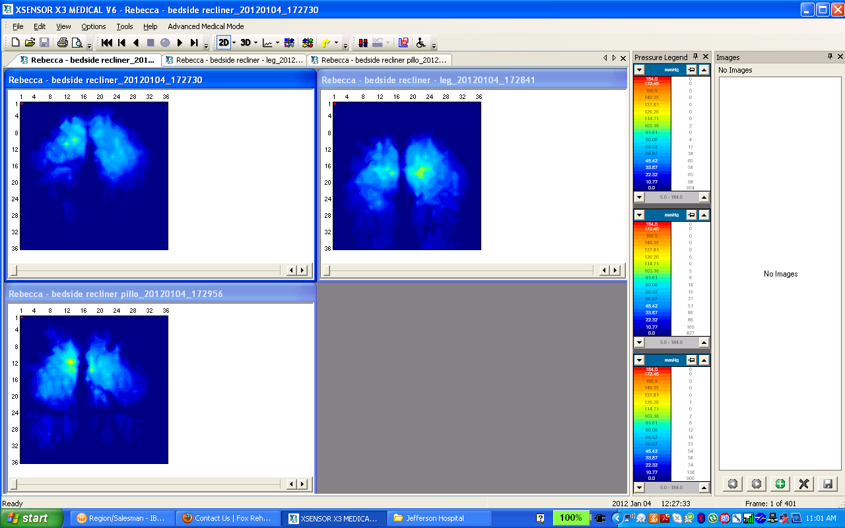
Seating Area/Contour
Contour seating surface is superior over flat surface*
Bedside chairs have memory foam cushions with qualities sensitive to weight, temperature, and molding to a patients body
Bedside Chair
Bedside chair with
pillow
*Sprigle 1990
Notes:
More uniform pressure distribution
Pillow is exta padding
14

Slide 15
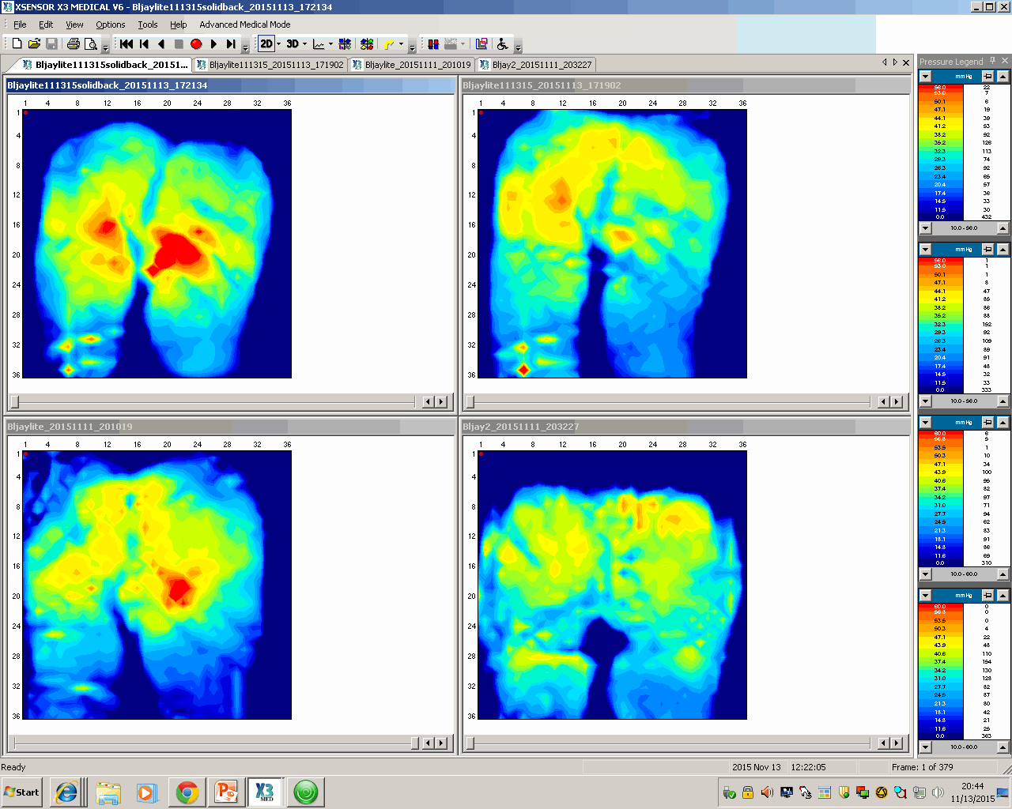
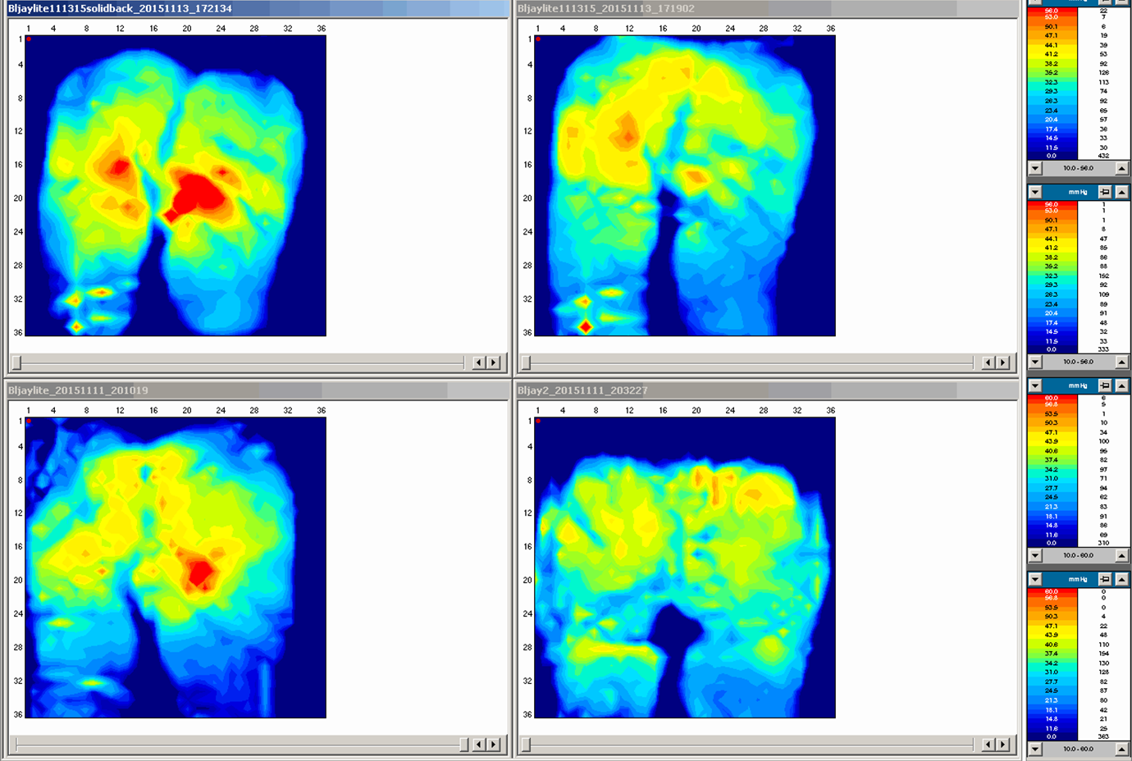
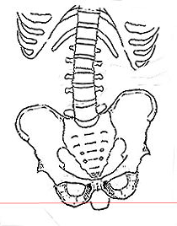
Symmetry/Obliquity
Notes:
Is the patient leanbing left or right
Is it a result of pelvic obliquity

Slide 16
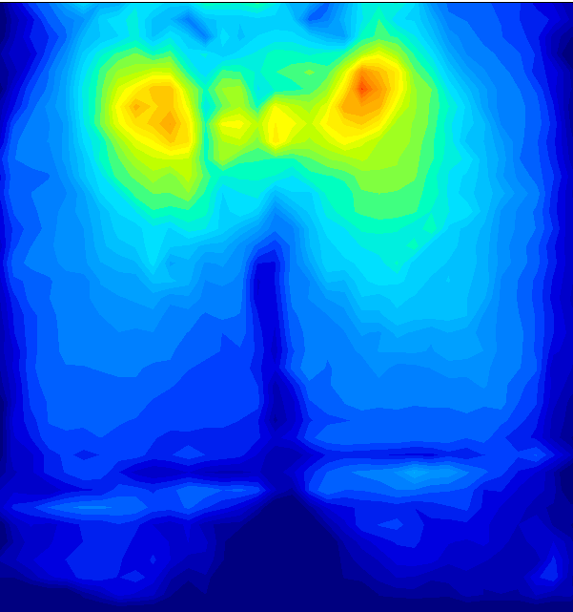
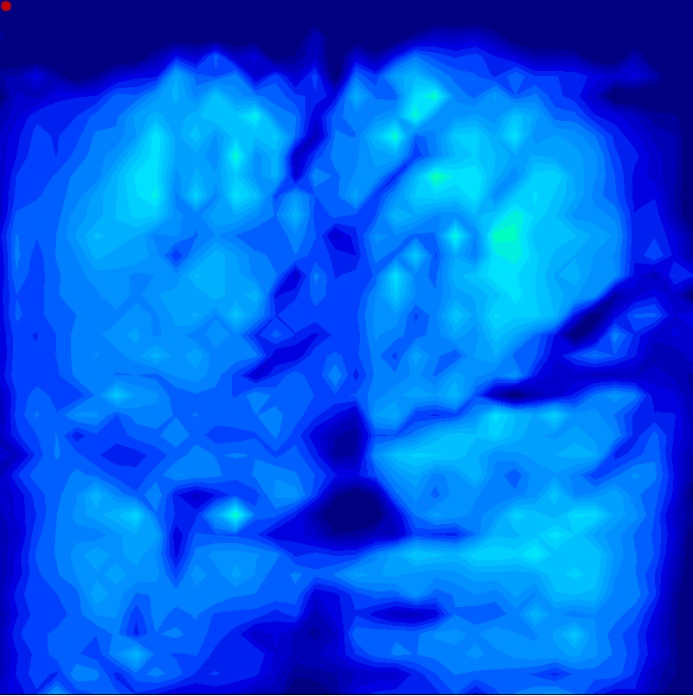
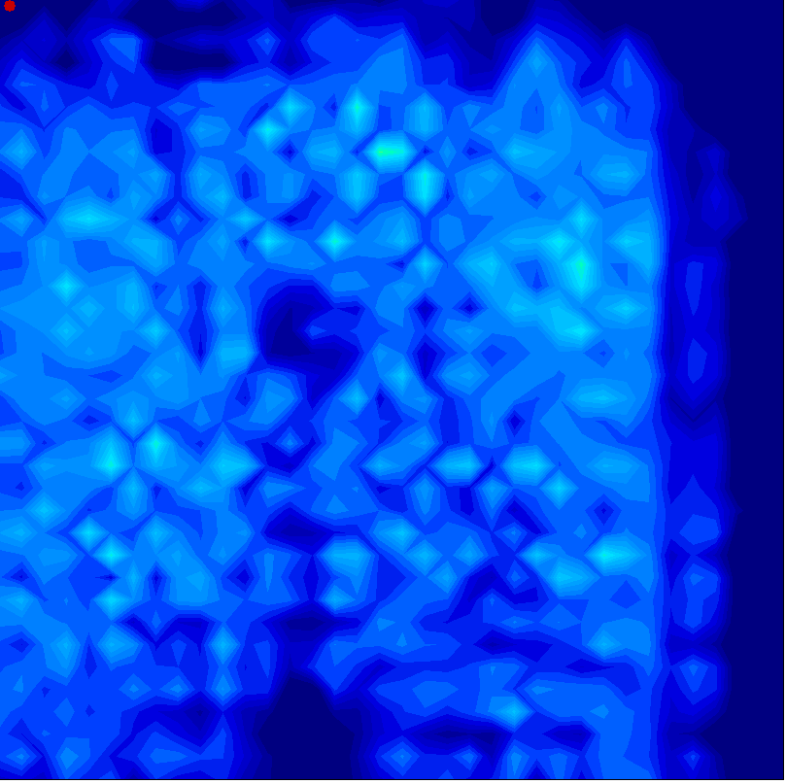
Clinical Question: Which cushion will be most beneficial to prevent wounds?
Foam Cushion
Gel Cushion
Air Cushion
Notes:
Send patients home with wheelchairs

Slide 17
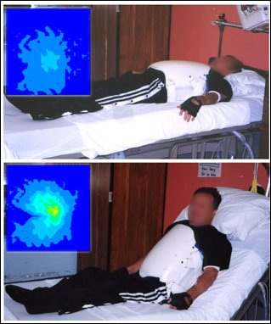
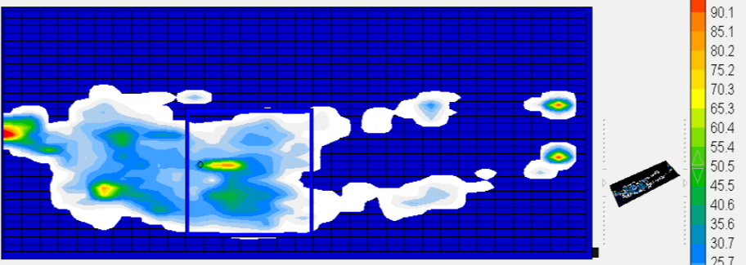
Clinical Question: How important is head of bed angle?
Goodman and Jacobs, Betz

Slide 18
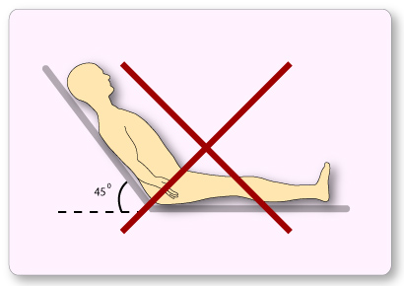
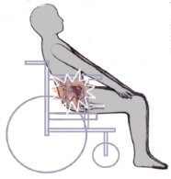
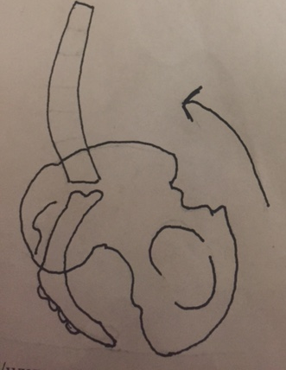
HOB Elevation → Sacral Sitting

Slide 19
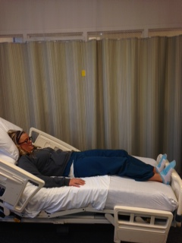
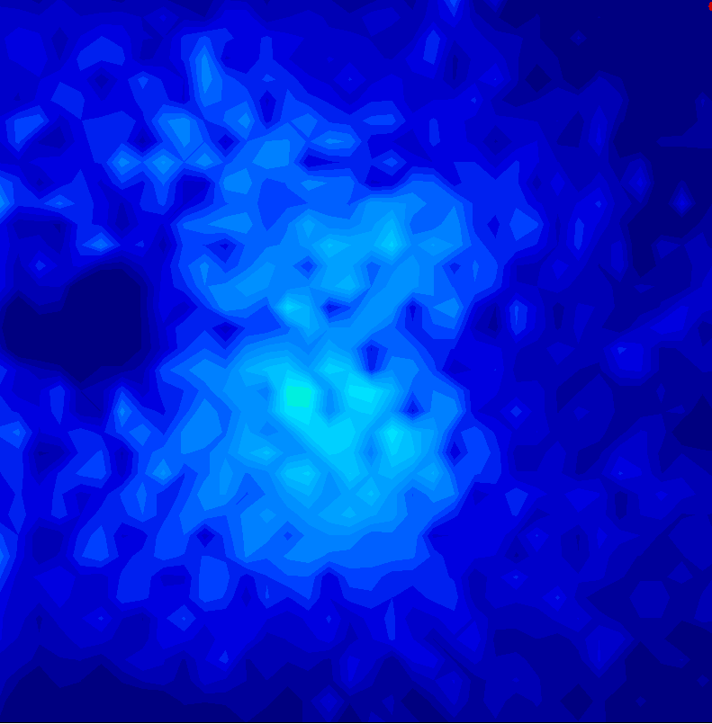
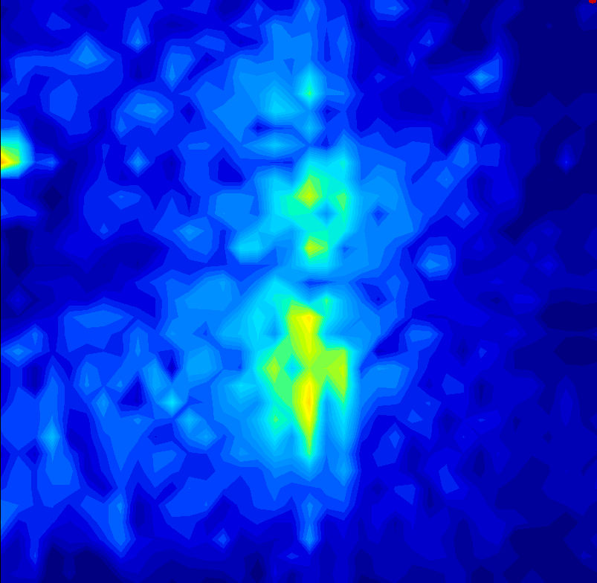
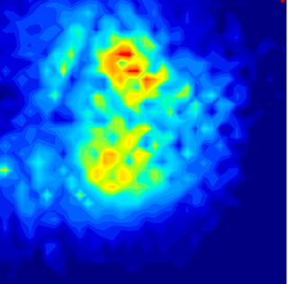
Clinical Question: We know that there is shear when patients slide to the foot of the bed, is there more pressure?
The highest values of shear force occurred when the subject’s position was shifted 10 cm toward the foot of the bed
Patients should be positioned at the bending conformity point or shifted 10 cm from that point toward the head of the bed*
HOB 30°
HOB 30°
HOB 30°
Hips at bed bend
5cm toward foot of bed
10cm toward foot of bed
*Mimura

Slide 20
Effects of Positioning on Pressure
Pressures were significantly lower when sitting in an upright chair with feet on floor (A) than sitting in an upright chair with legs on legrests (B)*
*Defloor et al

Slide 21
Bedside Chair Variations
Bedside Chair
Bedside Chair with Legrests Elevated

Slide 22
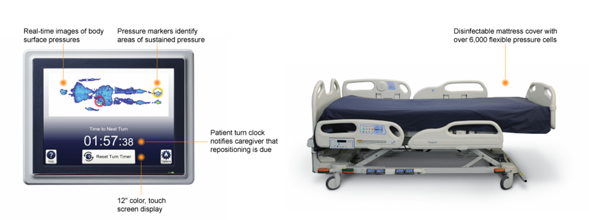
The Future:
Continuous Pressure Mapping Surfaces
Continuous visual feedback
Prevention of magnitude and duration of pressure points
Evaluates effectiveness of off-loading
Timely and documented weightshifting/repositioning

Slide 23
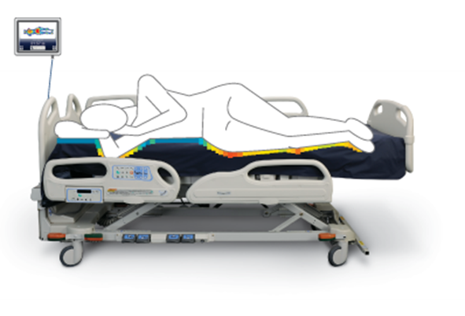
Clinical Question: Can continuous pressure monitoring prevent pressure ulcers?
Pilot studies (non-RCT’s) of continuous mapping have shown positive effects on:
    Rate of repositioning/turning by healthcare members
    Effectiveness of pressure distribution with turns
    Patient and family request and participation in weightshifting
First RCT in progress (Wong et al)

Slide 24
Case Study
51 year-old male with …
  Diagnosis of T2 spinal infarct
  Admitted with Stage II ischial wound and unstagable sacral wound
  Presentation consistent with T2 ASIA A SCI
  Admitted with mechanical ventilation
  Multi high risk factors for skin breakdown

Slide 25
Case Study #2
Continence Status
Incontinent of bladder
Incontinent of bowel
Pulmonary Status
Vent Dependent
Pulmonary Fibrosis
History of Lung Cancer
Nutritional Status
Low pre-albumin
NPO
Dobhoff Tube
Functional Status
Non-ambulatory
Dependent weight shifts
Dependent for ADLs

Slide 26

Seating Recommendations
"I am not getting back in that bed“
“I can’t breathe”
What does the evidence say?
Bedrest
OOB for meals and therapies

Slide 27
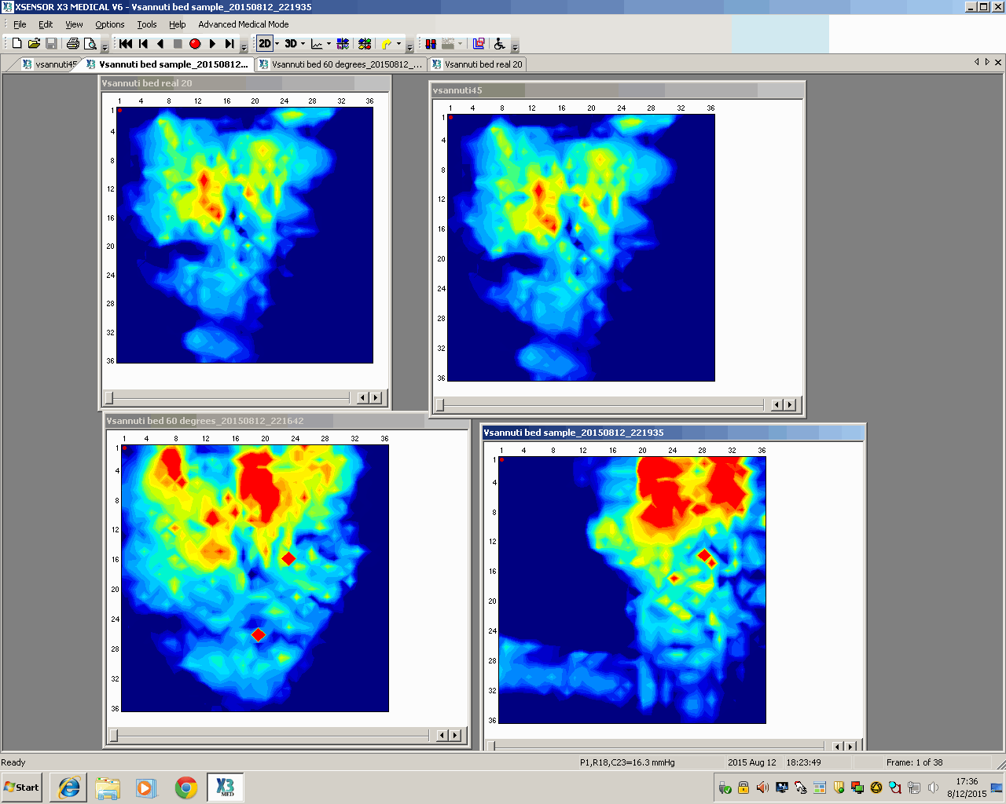
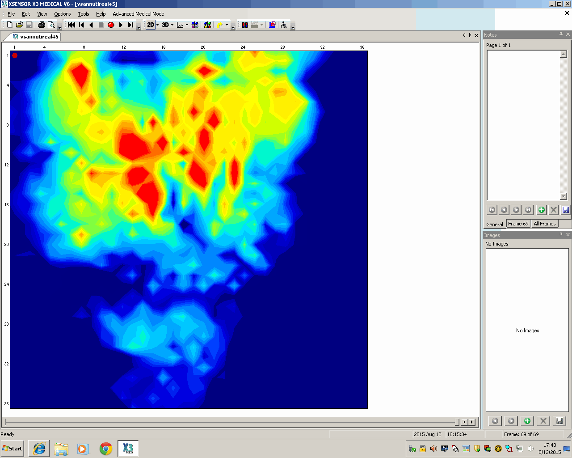
L = Left Ischium
R= Right Ischium
S = Sacrum
(Avg Pressures in mmHg)
HOB Positions
HOB 20°
L =44.7
R= 38
S= 39
HOB 45° L = 70.5 R= 70
S= 80.4
L
L
R
R
S
S
Sidelying with wedge
HOB 20°
L = 0
R= 46.8
S= 0
HOB 60°
L = 66.5
R= 86.6
S= 256.0
R trunk
L
R
R
S
S
*
* = therapist’s arm

Slide 28
30º Sidelying Position
HOB less than 30º
Wedge or folded pillow
above sacrum
Pillow between knees
30º
PVA 2014
Notes:
Should be able to fit hand between mattress and sacrum

Slide 29
30º Sidelying Position
Redistributes weight from bony areas to areas of larger muscle mass
Studies indicate that contact pressure is transferred to a lower risk area (gluteal muscles)
-Gluteal muscles can tolerate pressure up to 3.5 times higher than those tolerated over bony prominences*
*Colin et al

Slide 30
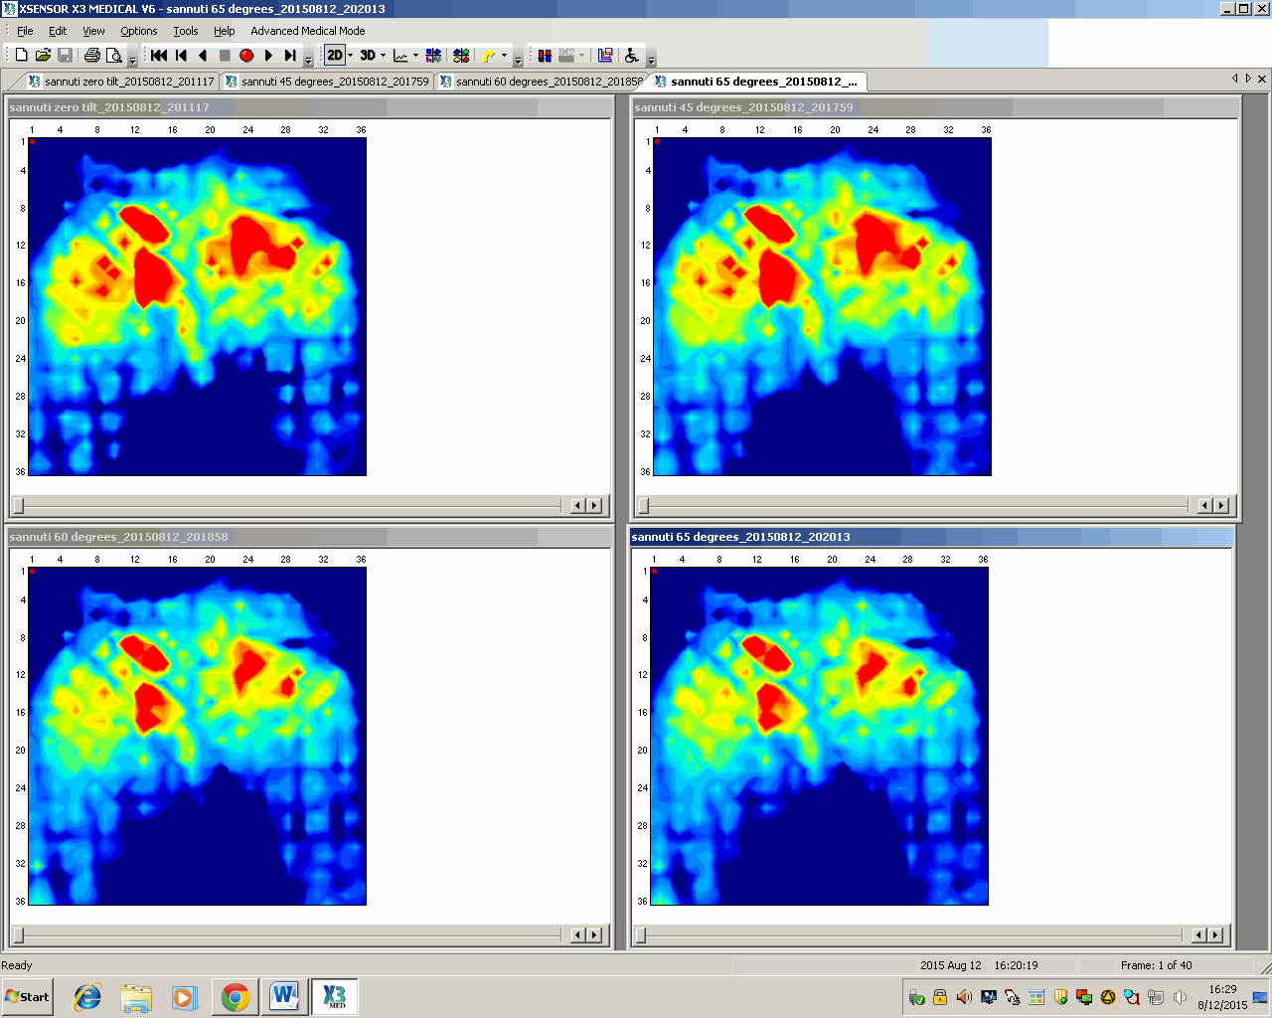
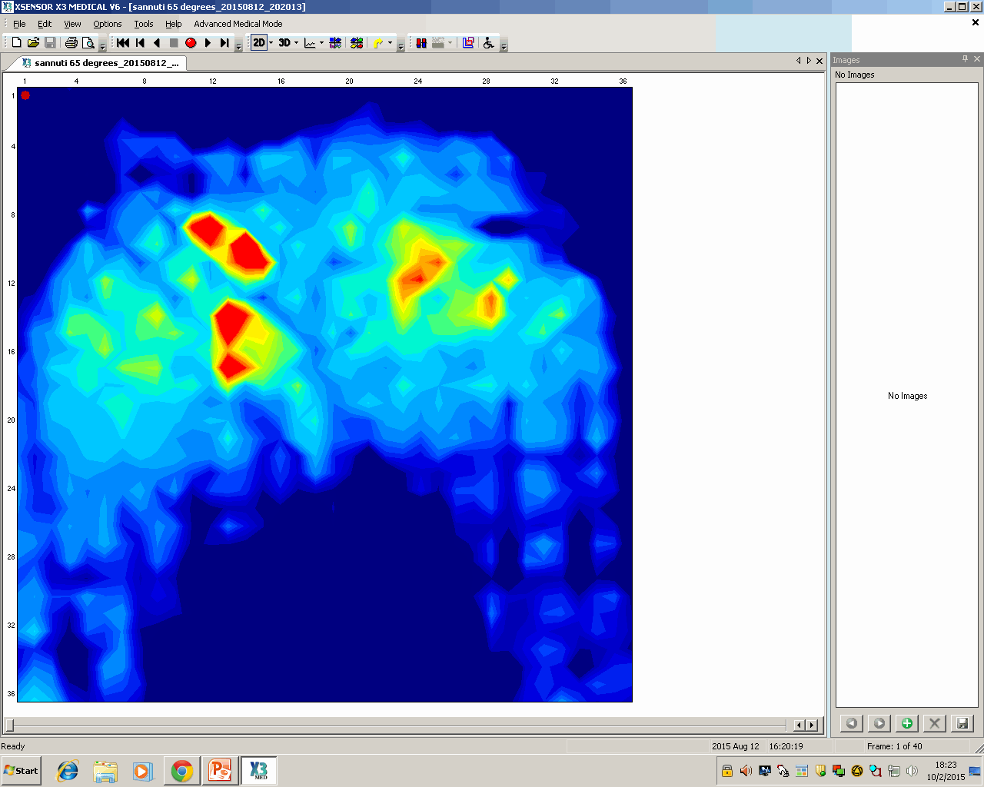
L = Left Ischium
R= Right Ischium
S = Sacrum
(Avg Pressures in mmHg)
Power Tilt Positions
5° tilt
L = 100.7
R= 98
S= 0
30° tilt
L = 89
R= 88.1
S= 0
45° tilt
L = 65.1
R= 78.7
S= 0
60° tilt
L = 59.5
R= 65.8
S= 0

Slide 31
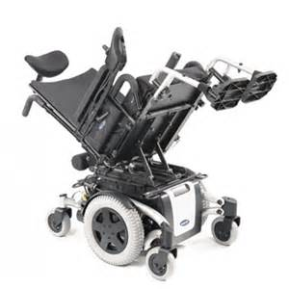
Effects of Positioning on Pressure
Defloor et al* quantified interface pressures in different positions
Lowest pressures were in a tilted back chair
Pressure distributed to larger surface area of back
*Defloor
www.invacare.com
Notes:
Tilt not recline

Slide 32

Summary of Pressure Mapping
Best position for minimal pressure at sacral and ischial areas:
  30 degree sidelying with wedge with HOB less than 30 degrees
    Also supported by literature*
Next best position for minimal pressure at sacral area and reduced at ischial area = tilt in space wheelchair at 60 degree tilt, open area between seat cushion and back
wound offloading
work of breathing

Slide 33
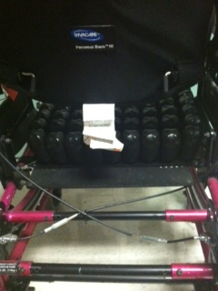
Sacral/Coccygeal Pressure Relief in Tilt Chairs
Chair is configured for space
between the inferior aspect of
the wheelchair back and the
superior aspect of the cushion to
unweight sacrum/coccyx
Pelvis remains stable/neutral in
tilt-in-space system, thus, no increase
In sacral/coccygeal pressure with
tilt

Slide 34
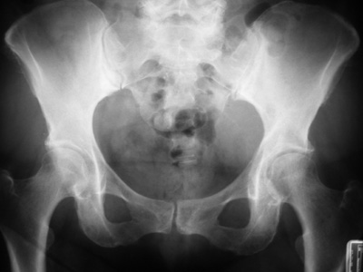
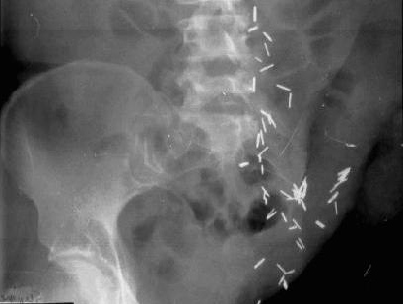
Clinical Question
Will sitting after a left hip disarticulation put too much pressure on the incision?
http://www.cedars-sinai.edu/Patients/Programs-and-Services/Imaging-Center/

Slide 35
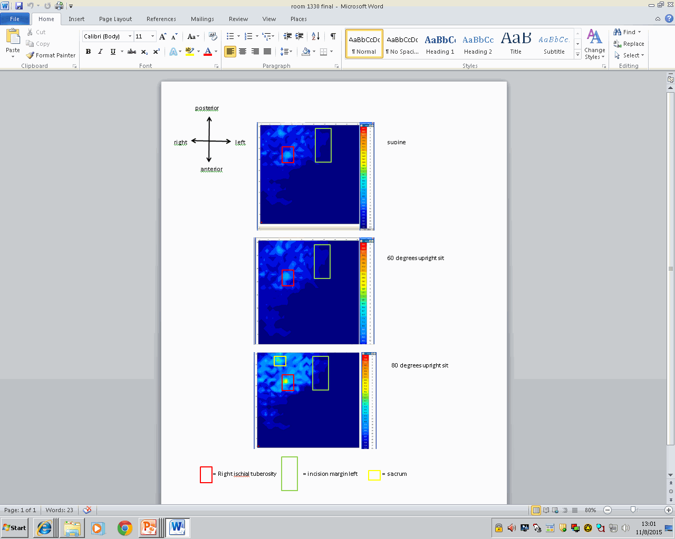
Supine
60 degrees
Upright Sit
80 degrees
Upright Sit

Slide 36
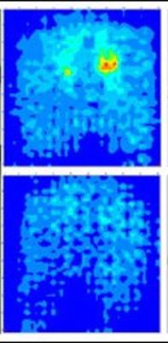
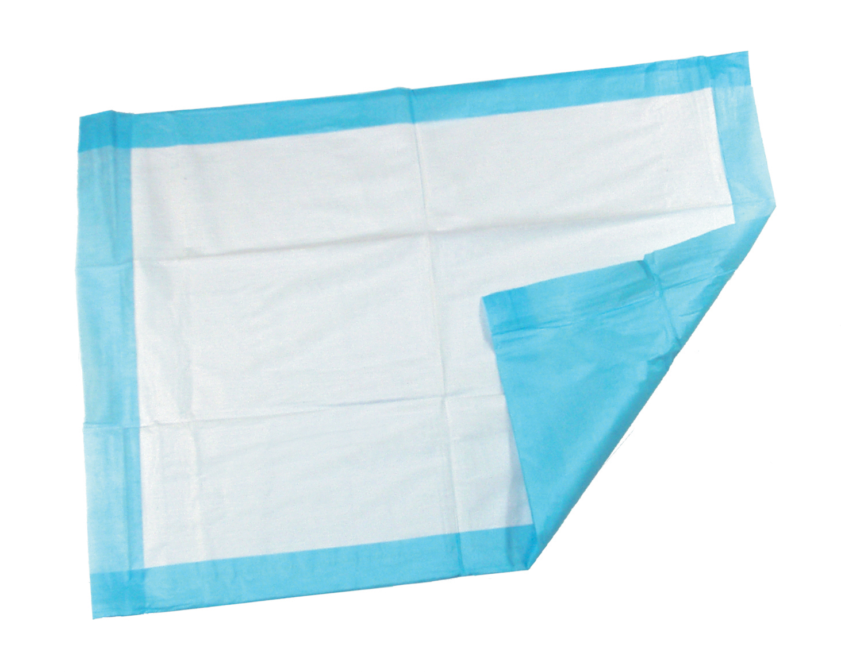
Other Considerations:
Wound dressings can cause an increase in pressure*
Presence of an underpad between patient and support surface ⬆ peak pressure 20 – 25%**
Beware of medical devices that can cause pressure…
*Betz
**Fader 2004

Slide 37
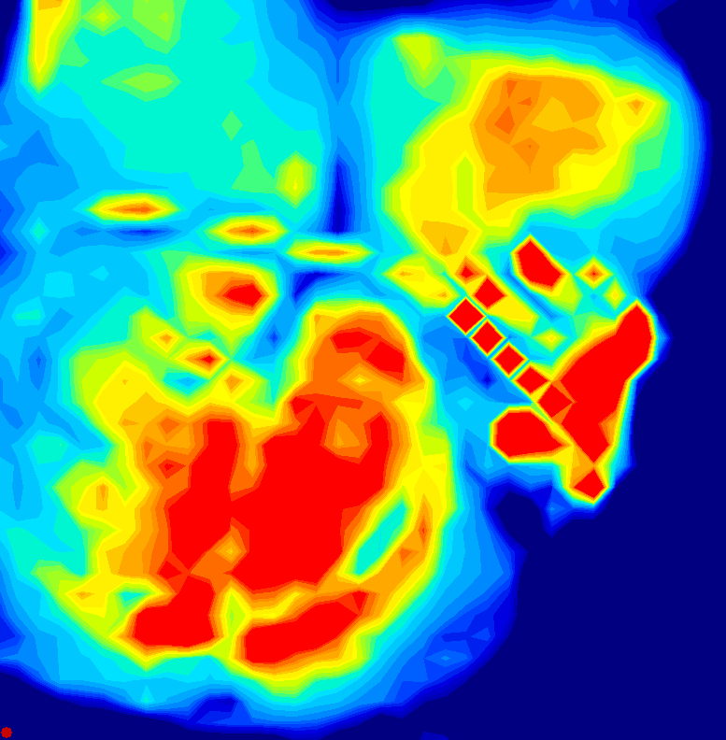

Slide 38
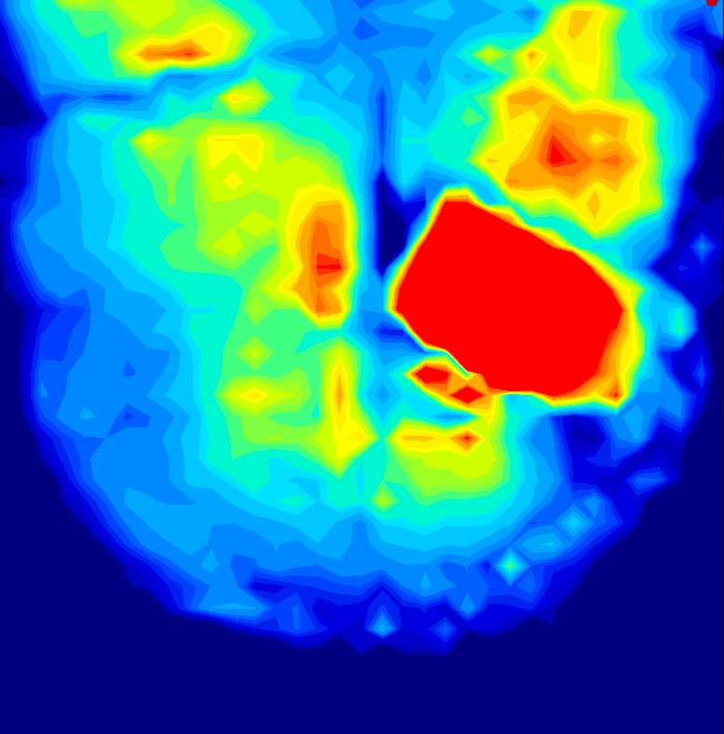

Slide 39
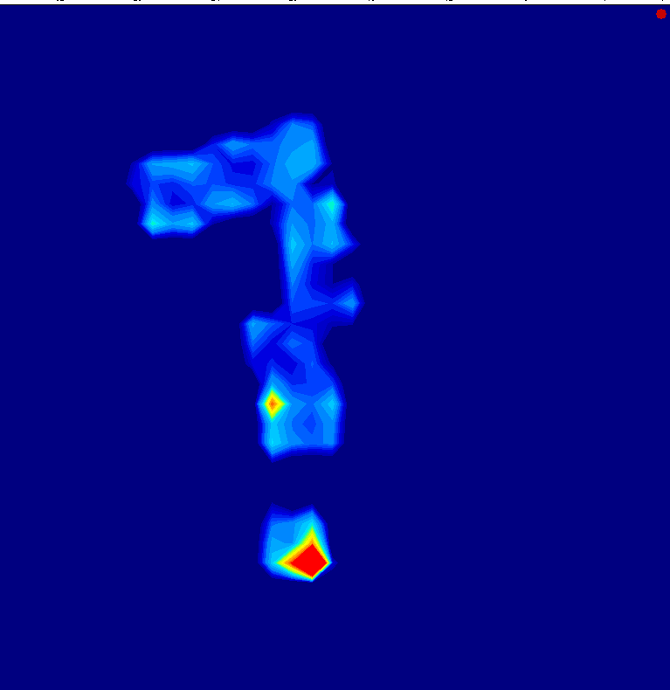
‘s

Slide 40
References
Bar, C. (1998).Pressure: Why measure it and how. A presentation at the 14th International Seating Symposium. Vancouver, BC
Bennett et al. Skin stress and blood flow in sitting paraplegic patients. Arch Phys Med Rehabil, 65 (1984), pp. 186–190
Betz, K. Picture this ... Pressure Mapping Assessment for Wheelchair Users. University of Washington SCI Forum Reports 2004.
Colin D et al. Comparison of 90 degree and 30 degree laterally inclined positions in the prevention of pressure ulcers using transcutaneous oxygen and carbon dioxide pressures. Advances in Wound Care. 1996:9; 35-38.
Fader, M., Bain, D. and Cottenden, A. (2004), Effects of absorbent incontinence pads on pressure management mattresses. Journal of Advanced Nursing, 48: 569–574.
Ferguson-Pell, M. & Bain, D. (1999). Pressure mapping in the community: detecting sitting behaviours that increase pressure sore risk. Proceedings of the Fifteenth International Seating Symposium. Pittsburgh: University of Pittsburgh.
Gefen,A. How Much Time Does it Take to Get a Pressure Ulcer? Integrated Evidence from Human, Animal, and In Vitro Studies. Ostomy Wound Management. 2008:54(10):26-35
Landis, E. M.: Micro-injection studies of capillary blood pressure in human skin. Heart, 15: 209, 1930.
Linder-Ganz E et al. How do normals move during prolonged wheelchair-sitting? Technol Health Care. 2007;15(3):195-202

Slide 41
References
•Linder-Ganz E, Engelberg S, Scheinowitz M, Gefen A. Pressure-time cell death threshold for albino rat skeletal muscles as related to pressure sore biomechanics. J Biomech. 2006;39(14):2725–2732.
• Mimura M, Ohura T, Takahashi M, Kajiwara R, Ohura N Jr. Mechanism leading to the development of pressure ulcers based on shear force and pressures during a bed operation: influence of body types, body positions, and knee positions. Wound Repair Regen. 2009;17:789-796.
•Nanjo et al. Relationship Between Morphological Characteristics and Etiology of Pressure Ulcers in Intensive Care Unit Patients. J Wound Ostomy Continence Nurs. 2011;38(4):404-412.
• National Pressure Ulcer Advisory Panel, European Pressure Ulcer Advisory Panel and Pan Pacific Pressure Injury Alliance. Prevention and Treatment of Pressure Ulcers: Quick Reference Guide. Emily Haesler (Ed.). Cambridge Media: Osborne Park, Western Australia; 2014.
• National Pressure Ulcer Advisory Panel and European Pressure Ulcer Advisory Panel. (2009). Prevention and treatment of pressure ulcers: clinical practice guideline. Washington DC: National Pressure Ulcer Advisory Panel.
• Parry E, Strickett T. The pressure is on - everyone, everywhere, everyday. TSS Group, www.tssgroup.net.au. Retrieved 9/6/15
• Shapcott, N. & Levy, B. (1999). By the numbers: Making the case for clinical use of pressure measurement mat technology to prevent the development of pressure ulcers. Jan, p 16-21.
• Sprigle, S. et al.. Reduction of sitting pressures with custom contoured cushions. J Rehabil Res Dev 27 (1990): 135–40.

